Slide 1

Python Basics
Instructor: Elena Fernández Fernández

Slide 2
TABLE OF CONTENTS
General Introduction
Introduction to Programming
Python Syntax
Data Types: float, strings, Boolean, Intergers, Null/NA.
Data structures: lists [], tuples(), dictionaries {}, string.
Methods
Functions
Control Flow
Debugging
Basics of reading and writing files.

Slide 3




DAY 1
1. General Introduction
2. Introduction to Programming
3. Python Syntax
4. Data Types (String, Float, Integer, Boolean)

Slide 4
1. General Introduction
Instructor Introduction
Students Introduction
Introduction to the course

Slide 5
About me
Education
B.A. English Philology, University of Salamanca, Spain (2006-2011).
M.A. Spanish Studies, University of Virginia, USA (2011-2013).
PhD Hispanic Languages and Literatures, University of California, Berkeley (2013-2019).
Work Experience
Data Science Post-doctoral researcher, Technical University of Munich (2019-2021).
Data Science Post-doctoral researcher, Institute of Computational Linguistics, UZH (2021-2023).
Lecturer, IT Zentrale Informatik, University of Zurich (2023-).
Areas of Research
Digital Humanities
Computational Social Science
Media and Communication Studies.

Slide 6
… and how about you?
Please introduce yourself!

Slide 7
Learning Objectives
After this course…
You will have an idea about what programming is.
You will be able to write basic Python scripts.
You will know where to find information to improve your programming skills.

Slide 8
Tips for this course
It is always allowed to ask questions.
Every day after class I will ask for your feedback: understanding your learning needs is very important to improve our class!
Try to write yourself the Python scripts instead of copy-pasting.
Don´t be afraid of making mistakes ☺
Experiment and modify existing code
Use google and stack overflow (https://stackoverflow.com/)
Use language models (I particularly like this one: https://www.perplexity.ai/)
Try to have fun!

Slide 9

2. Introduction to programming

Slide 10

What is Computer Science?
What problems can be solved using computation
The study of How to solve those problems, and
What techniques lead to effective solutions
Reference: CS61A Structure and Interpretation of Computer Programs, UC Berkeley. (https://cs61a.org/)

Slide 11

What is computational thinking?
Computers cannot study the world on their own. People must describe precisely what steps the computer should take, and those steps are expressed through programs.
Reference: Computational and Inferential Thinking (https://inferentialthinking.com/chapters/intro.html)

Slide 12

What are programming languages?
The way in which we can communicate with computers. That is why they are called “languages”.
Programming can dramatically improve our ability to collect and analyze information about the world. In data science, the purpose of writing a program is to instruct a computer to carry out the steps of an analysis.
Reference: Computational and inferentional thinking: https://inferentialthinking.com/chapters/03/programming-in-python.html

Slide 13
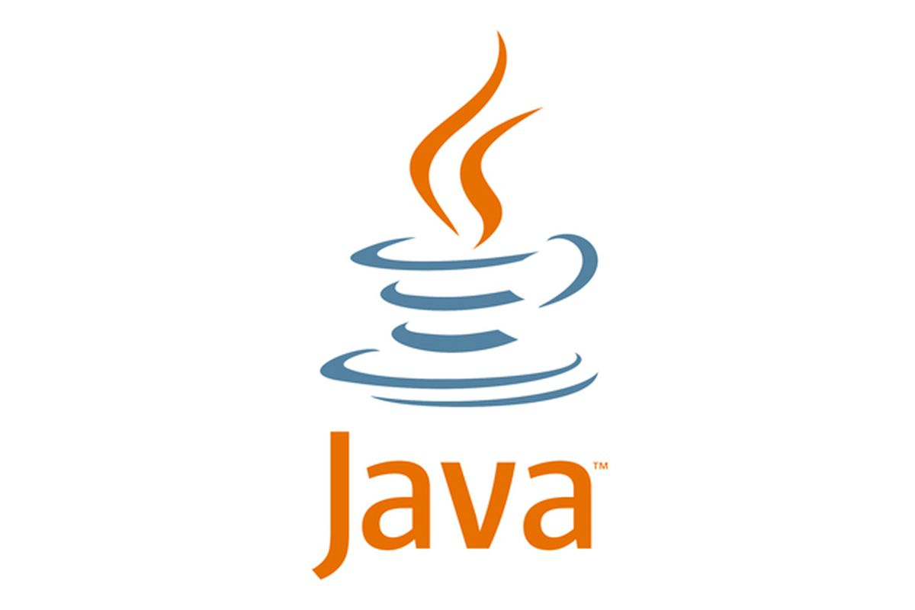
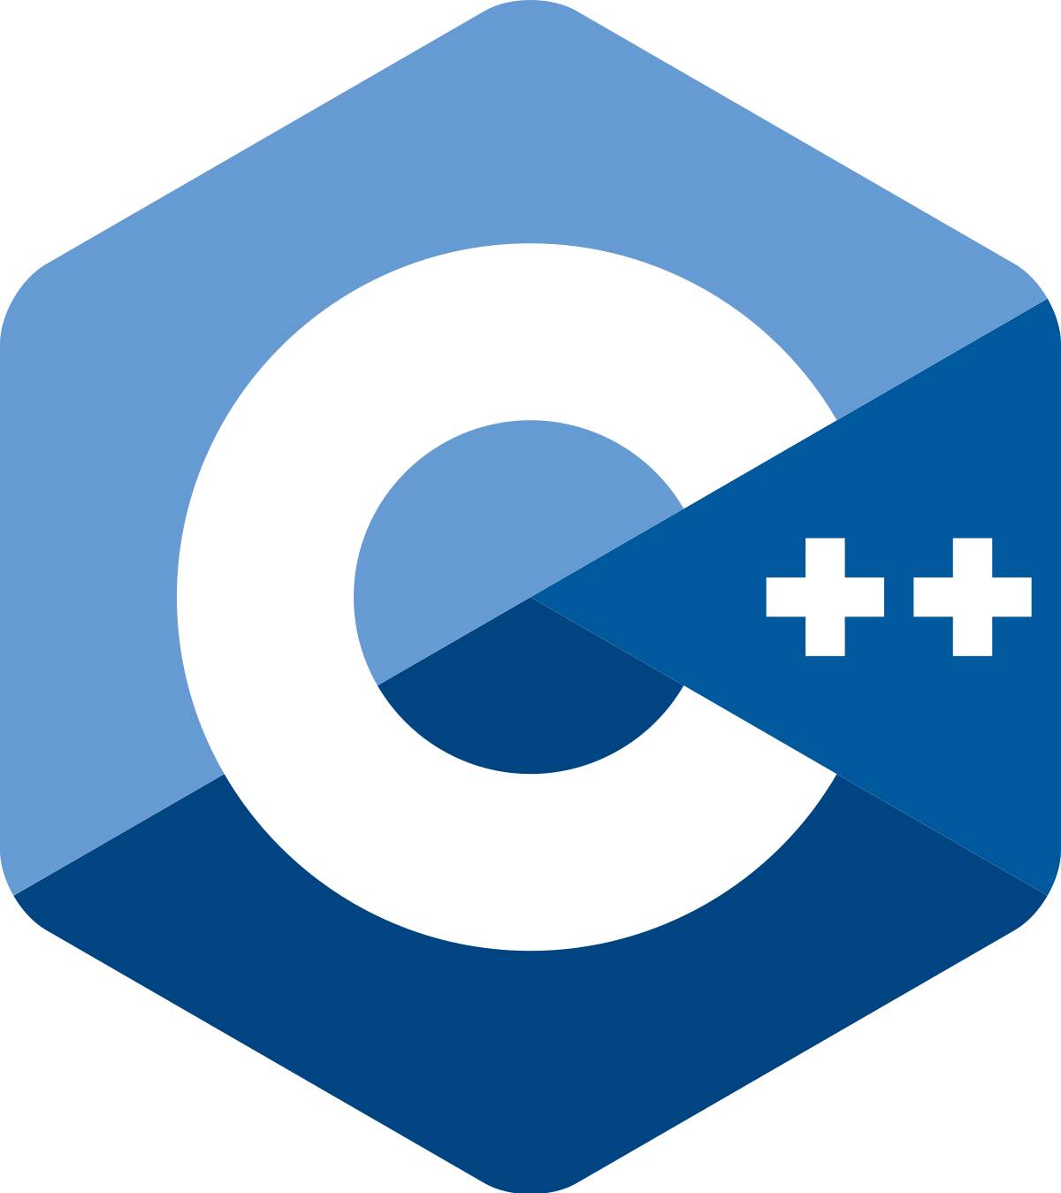
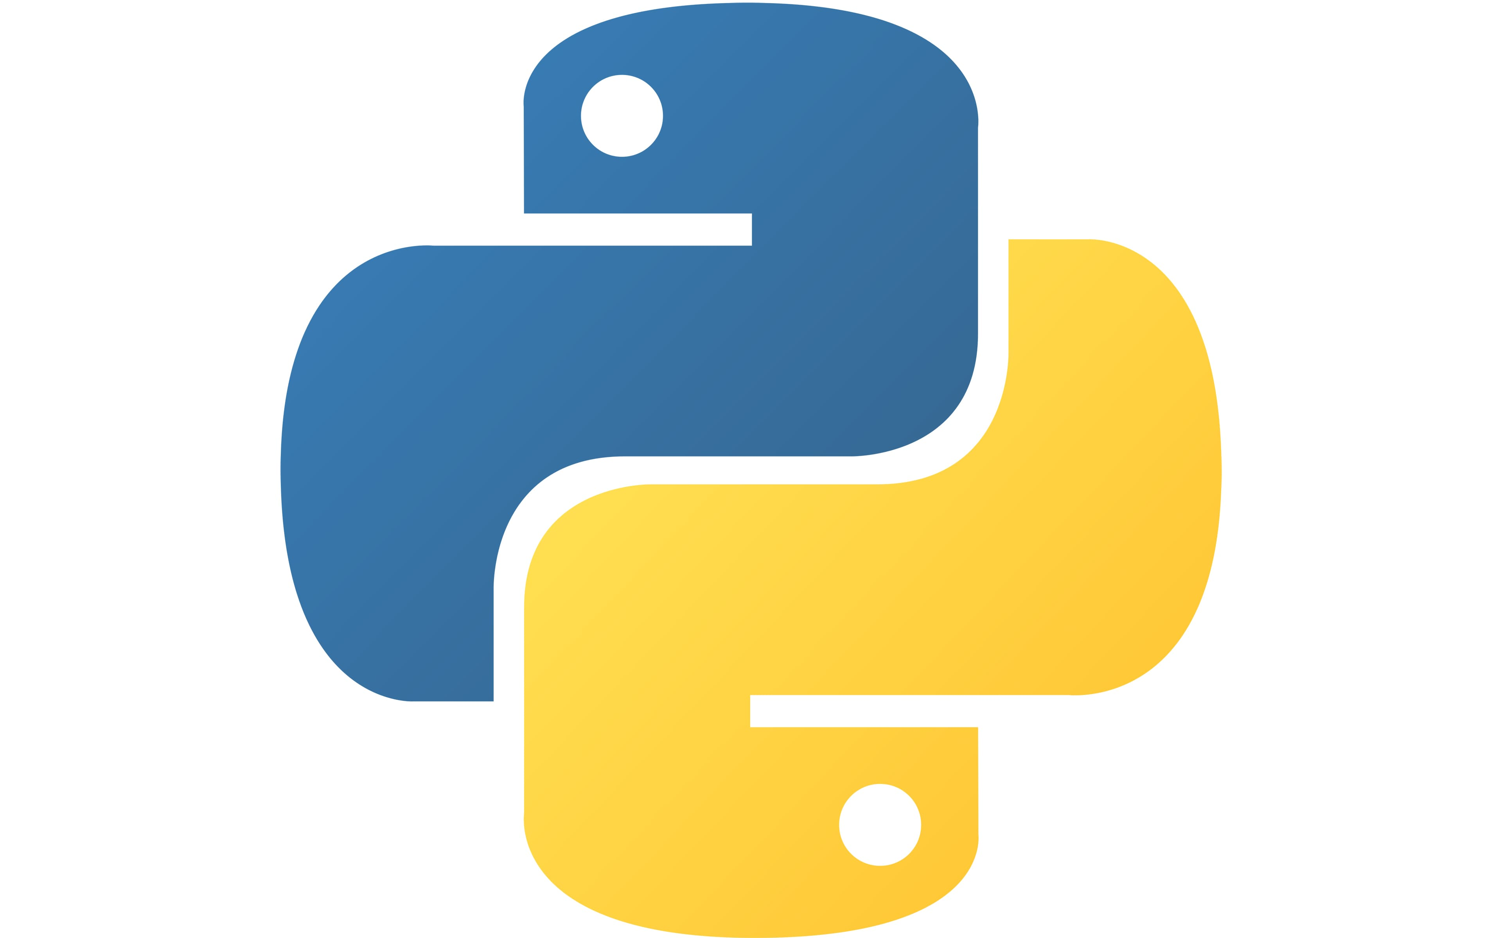

In the same way that there are many languages in the world…
Hallo! Hello! Hola! Bonjour! Ciao! Obrigada!
…there are also many programming languages!

Slide 14
3. Python Syntax

Slide 15
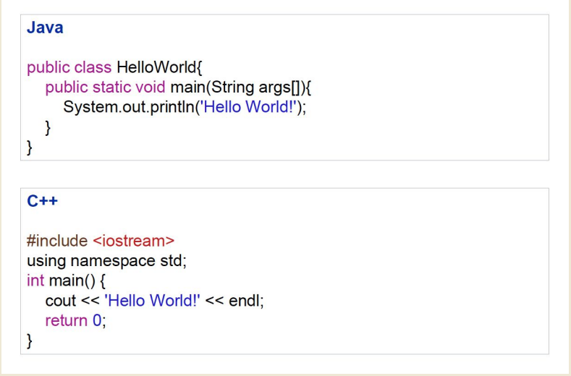
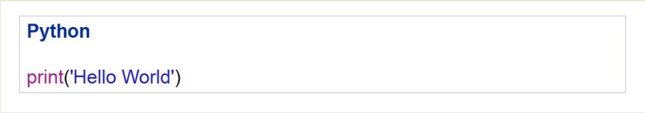
Programming languages also have syntax
These three examples are “communicating” the same thing. Which one is the simplest?

Slide 16

Why Python?
Did you know that Python was created by Guido van Rossum in the 1980s?
Simple syntax
Cross-platform (Jupyter Notebooks, Spyder, Pycharm…).
Many libraries available (nltk, pandas, numpy…).

Slide 17
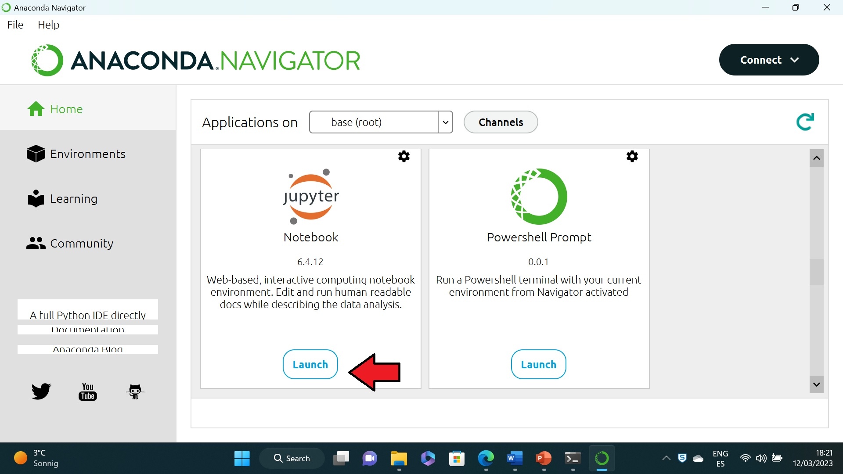
Python Interpreters
Makes sure that code is written correctly (syntax check).
Then compiles Python code and executes the code as well.
We will use the Python Interpreter “Jupyter Notebooks”.

Slide 18
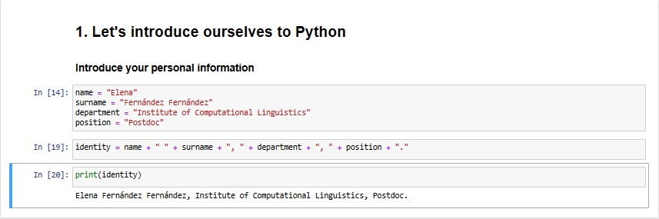
Run python scripts with Jupyter Notebooks
Live coding

Slide 19
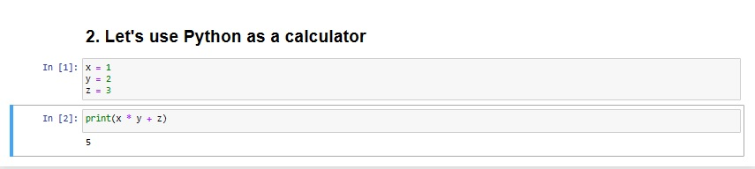
Python likes text, but also numbers.
Live coding

Slide 20
4. Data Types
String
Float
Integer
Boolean

Slide 21
Data types
2
Integers 10,000
-5 “Hello World”
NUMBERS TEXT (Strings) ‘Hello World’
1.3 “5”
Floats 3.222222
4.5

Slide 22
Boolean None Type
Binary data type None is a special type (in other languages also sometimes called
* True null or nullptr). Sometimes it is necessary to indicate that
* False something is not there and this can be indicated by using None

Slide 23
Question for the class
Which data type?
Literal | Data type?
“Good Morning” | ?
25 | ?
3.4 | ?
True | ?

Slide 24
Variables
Variables are used to store information to be referenced and manipulated in a computer program. They also provide a way of labeling data with a descriptive name, so our programs can be understood more clearly by the reader and ourselves. It is helpful to think of variables as containers that hold information. Their sole purpose is to label and store data in memory. This data can then be used throughout your program.
Variables hold values
x = 2
y = x + 2
Values are assigned using the = operator

Slide 25
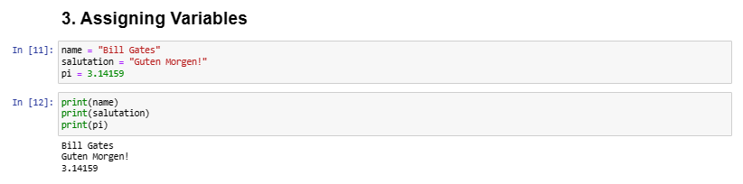
Examples of variables
Live Coding
It is important to use relevant names!

Slide 26
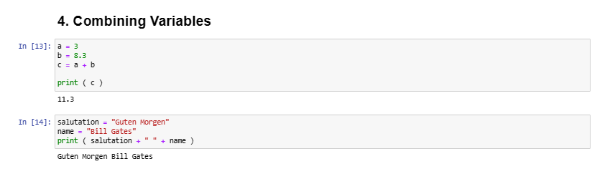
Variables and values can be combined
Live coding

Slide 27
… but some names are already taken!
You cannot name a variable with these names as Python already has them in storage
and , assert , break , class , continue , def , del , elif , else , except , exec ,
finally , for , from , global , if , import , in , is , lambda , not , or , pass ,
print , raise , return , try , while , yield

Slide 28
Operators
Operator | Operation | Example
(…) | Brackets | (2*3)+5
** | Exponent | 2**3
% | Module | 10%2
/ | Division | 20/4
* | Multiplication | 2*3
- | Substraction | 6-3
+ | Adition | 100 + 200

Slide 29
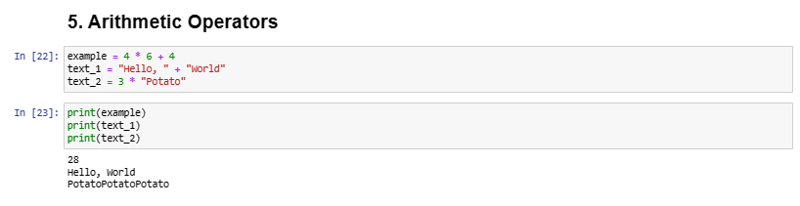
Arithmetic Operators
Live coding

Slide 30
Let’s try it out!
Live coding
Expression | Result
2 ** 3 + 2 * 3 | ?
3 * (4 + 3) | ?
2 ** (1 + 1) / 4 | ?
“Python” + “is” + “cool” | ?

Slide 31
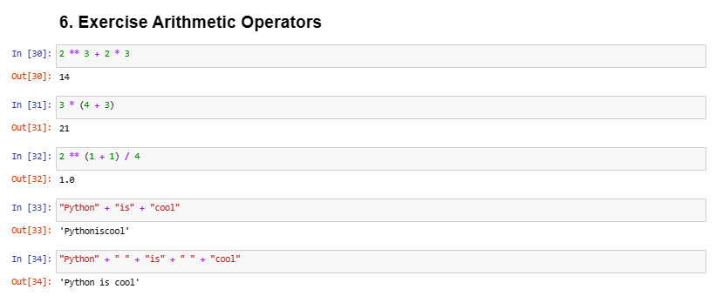
Live coding

Slide 32
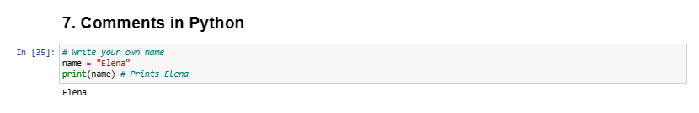
Comments
Comments have no impact on the program
• Should explain the code
• A comment starts with a # character

Slide 33

Exercises Day 1

Slide 34

Day 2

Slide 35
Day 2
Data structures (lists, tuples, sets, dictionaries)
Methods

Slide 36
1. Data Structures
Lists
Tuples
Sets
Dictionaries

Slide 37
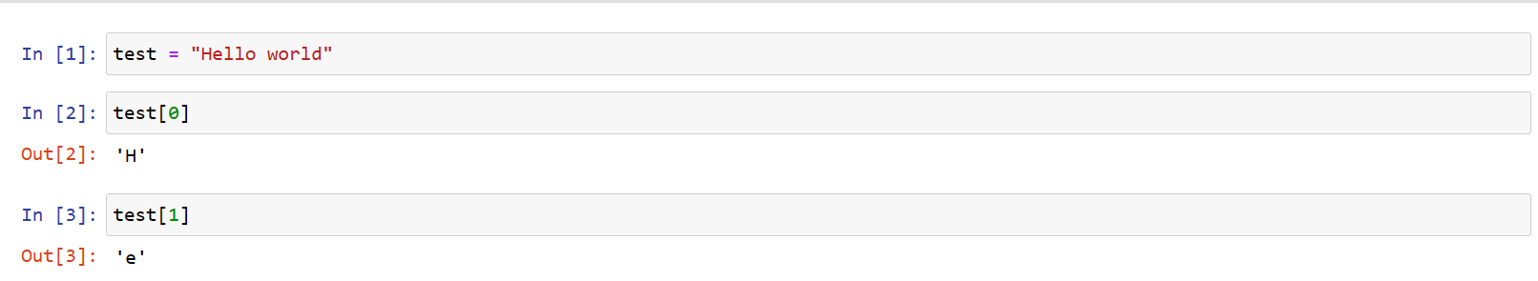
Python 0 indexing: an introduction
Python is a programming language where the first element in a data structure (for example: a list or a string) is always 0. This can get a little bit confusing:
H | e | l | l | o |  | w | o | r | l | d
0 | 1 | 2 | 3 | 4 | 5 | 6 | 7 | 8 | 9 | 10

Slide 38

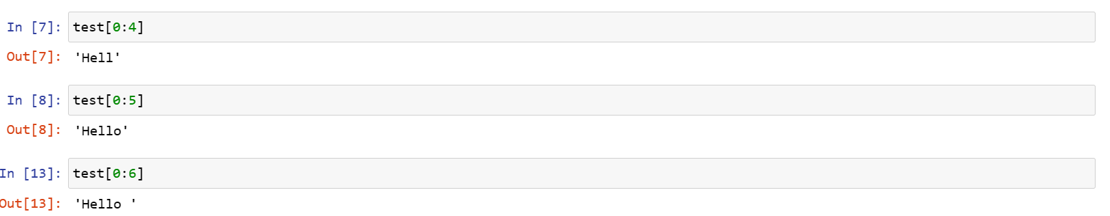
Moreover, to select the last element in a list, we always need to write one extra number. Very confusing!
Let’s have a look at what “Perplexity AI” says about this!: https://www.perplexity.ai/search/1943c75f-f5c0-4846-9d20-c9d74acbc840?s=u

Slide 39
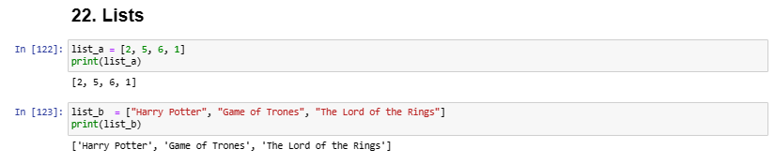
Lists []
Live coding
Lists are a data type
Lists are used in most programming languages (arrays)
Lists are a set of values

Slide 40
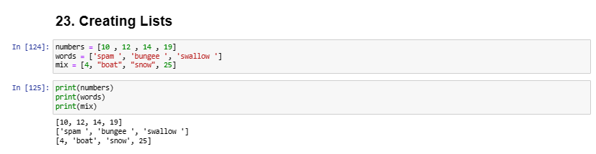
Creating Lists
Live coding
The easiest way to create a list is using []
Data types can be mixed

Slide 41
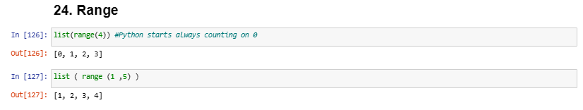
Creating lists
Live coding
Since numbers are often stored in a list, there is a special method for doing so: range.
With only one argument, range returns a number series starting at 0.
When using two arguments it is possible to define the start and end of the range [start, end) (end is not included in the list).

Slide 42
Creating lists
Live coding
The step size can be defined with a third argument.
An empty list can also be created (this is often done when the values in the list are not yet known).

Slide 43
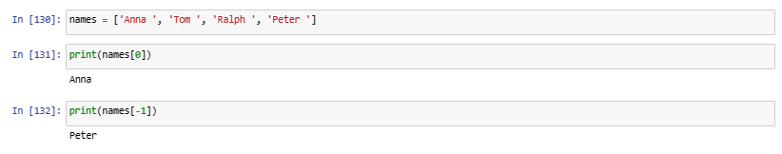
Accessing Lists
Live coding
Accessing elements can be done with the [] operator.
A negative index is used to access the list from the end.

Slide 44
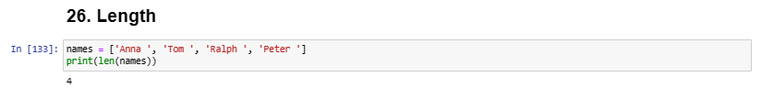
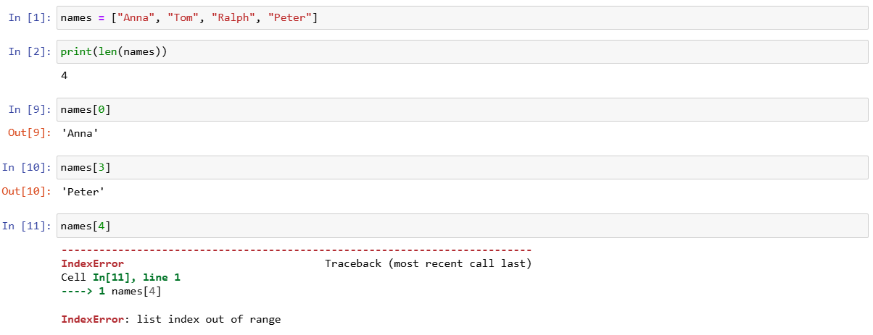
Length
Live coding
The number of elements in a list can be obtained using the len() function
OUT OF RANGE
If there is no item in the list at the desired index, Python will .print an error message

Slide 45
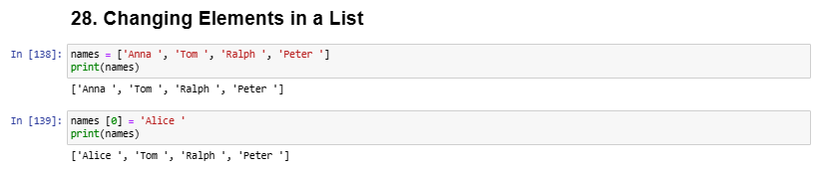
Changing elements in a list
An element can be changed using [INDEX]
Live coding

Slide 46

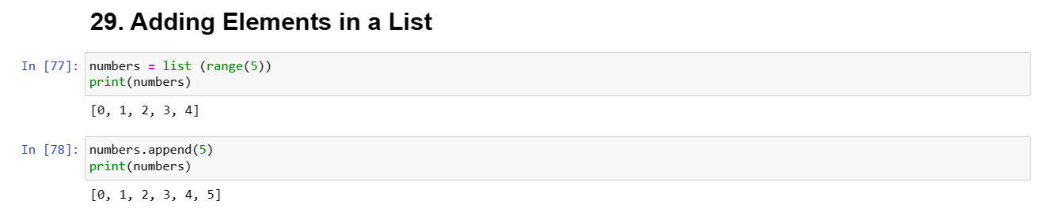
Adding elements in a list
We can add elements using append.

Slide 47
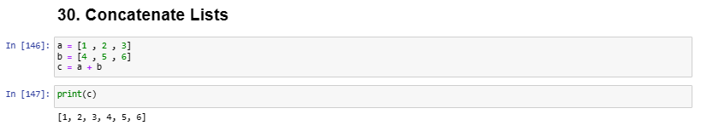
Concatenate lists
The + operator can be used to join lists.
Live coding

Slide 48
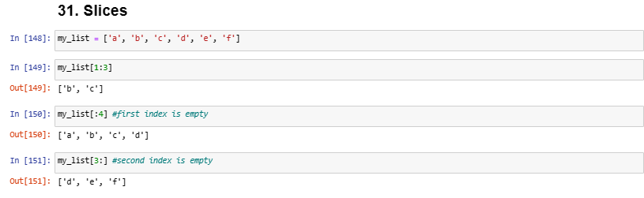
Slices
Live coding
Lists can be cut into slices.
The operator [n:m] returns a list of the elements that start at index n and stop before m.
If the first index is empty, the slice starts at the beginning.
If the second index is empty, the slice will include elements until the end of the list.

Slide 49
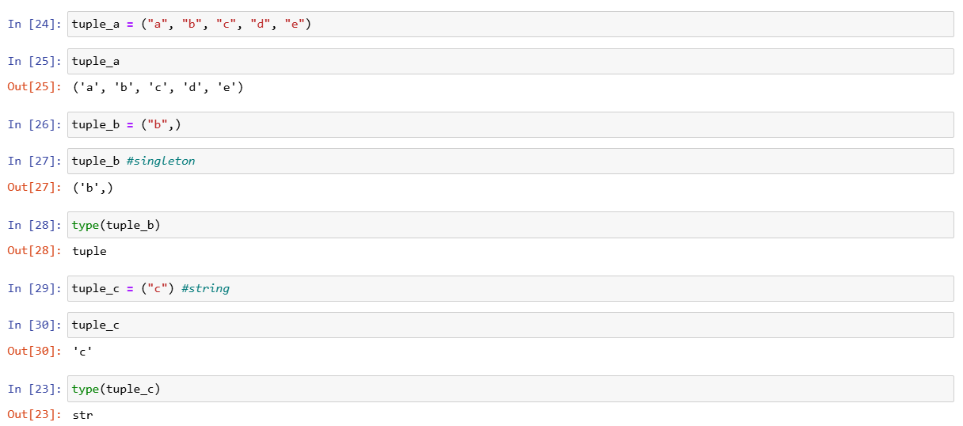
Immutables: Tuples and Strings
Live coding
Tuples are an immutable sequence data type.
Tuples are declared using () instead of [].
Tuples containing only one element (singleton) must have a comma at the end of the definition.

Slide 50
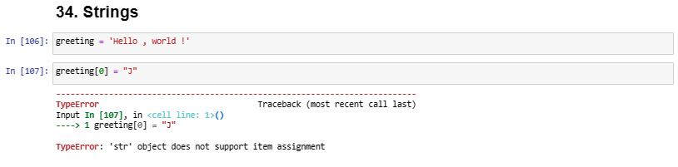
Strings
Strings are immutable.
Unlike lists, strings cannot be changed.
Operations on strings always return a modified copy of the string.
The original string remains unchanged.
Live coding

Slide 51
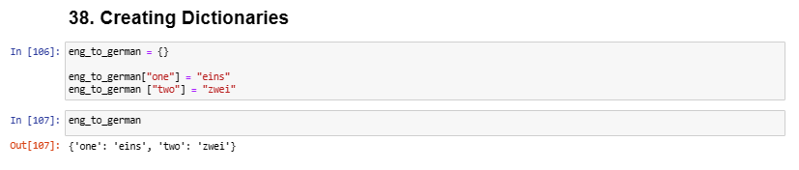
Dictionaries {}
Live coding
Key-Value pair.
Dictionaries are very similar to lists but have a key and value for each entry.
The entries of a dictionary are not sorted.
Dictionaries are created using {}

Slide 52
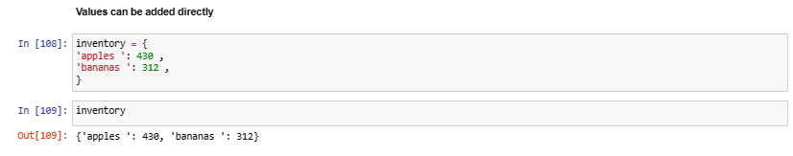
Dictionaries
Live coding
Values can be added directly.

Slide 53
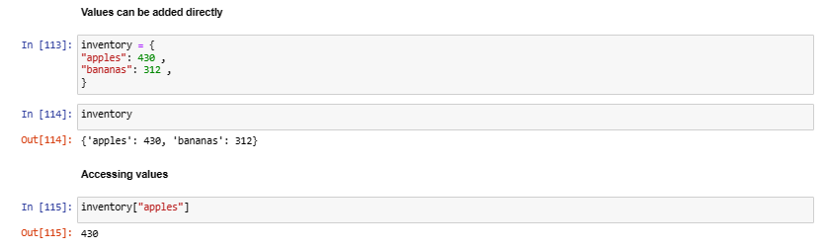
Dictionaries
Live coding
Accessing entries: values can be accessed directly using dictionary[’key’].

Slide 54
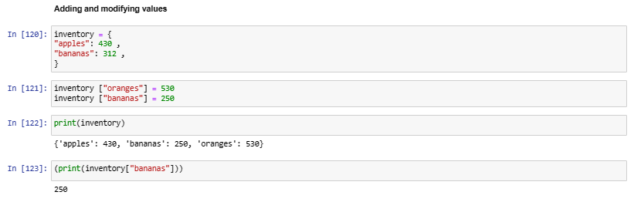
Dictionaries
Live coding
The key is assigned a value.
If the key already exists the existing value is overwritten.

Slide 55
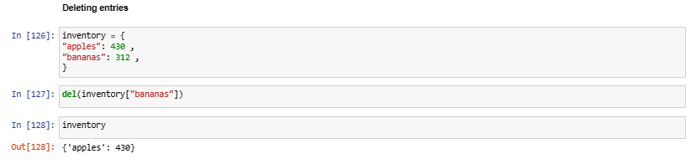
Dictionaries: deleting entries
Live coding
Key-Value pairs can be deleted using the del() method.

Slide 56
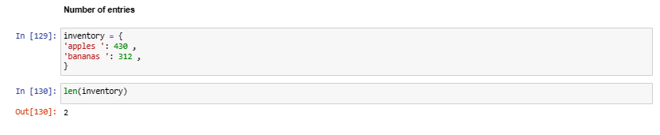
Dictionaries: number of entries
The len() function returns the number of entries.
Live coding

Slide 57
2. Methods
append(), del(),

Slide 58
Python: Object Oriented Programming
An important characteristic of the Python language is the consistency of its object model. Every number, string, data structure, function, class, module, and so on exists in the Python interpreter in its own “box,” which is referred to as a Python object. Each object has an associated type (e.g., integer, string, or function) and internal data. In practice this makes the language very flexible, as even functions can be treated like any other object.
Reference: https://wesmckinney.com/book/python-basics.html#semantics_everything_object

Slide 59
What is a method?
Almost every object in Python has attached functions, known as methods, that have access to the object’s internal contents. Some examples include:
append(), split(), strip(), join(), index(), find()
Reference: https://wesmckinney.com/book/data-cleaning.html#text_string_methods

Slide 60
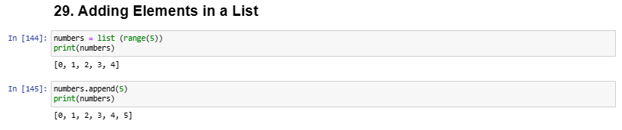
Adding elements in a list
Live coding
The append() method can be used to add an element at the end of the list.

Slide 61
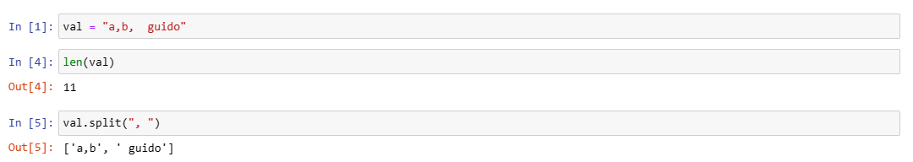
Split()
Live coding
The split() method can be used to break down strings.

Slide 62
Strip()
Live coding
Split() is often combined with strip() to remove whitespaces (including line breaks):

Slide 63
Join()
Live coding
To include extra text we can use the method join()

Slide 64
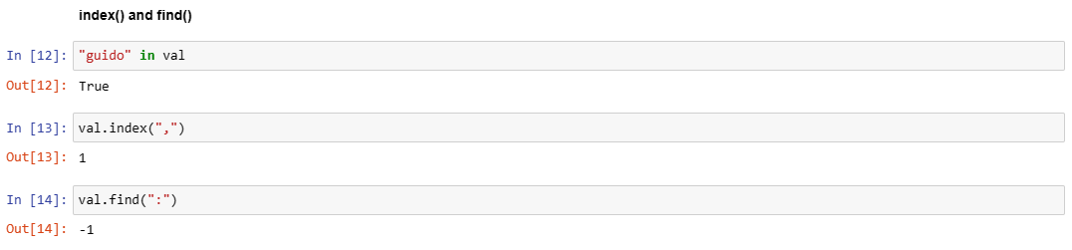
Index(), find()
Live coding
Other methods are concerned with locating substrings. Using Python’s in keyword is the best way to detect a substring, though index() and find() can also be used:

Slide 65

Exercises Day 2

Slide 66

Day 3

Slide 67
Day 3
Functions
Control Flow
Debugging

Slide 68
3. Functions
Build-in Functions
User defined Functions
Functions with Return Value

Slide 69
Functions in Python
Build-in Functions
User defined Functions
Functions with Return Value

Slide 70
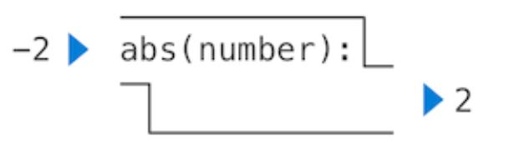
Build-In Functions
Functions have some input (their arguments) and return some output (the result of applying them). Built-in functions can be depicted as a small machine that takes input and produces output.
For example: abs(-2)
2
Reference: “Composing Programs” (http://composingprograms.com/)

Slide 71
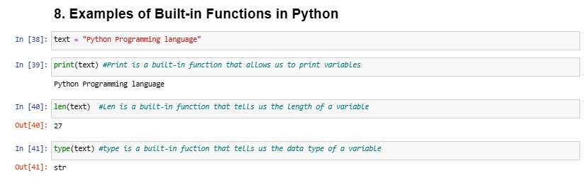
Examples of Built-in Functions in Python
Live Coding

Slide 72
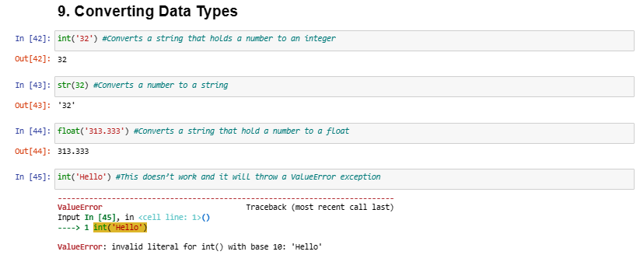
Type Convertions
Live coding
Python allows us (using built-in functions) to convert data types.

Slide 73
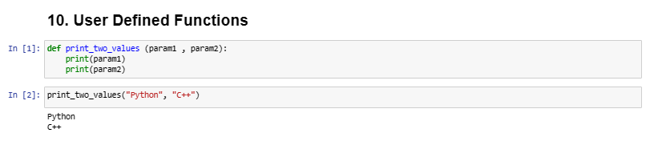
User defined Functions
User-defined functions are used similarly as built-in functions. The difference is that now users (i.e., ourselves) decide how to create them. Syntax is important: indentation, the colon.
Live Coding

Slide 74
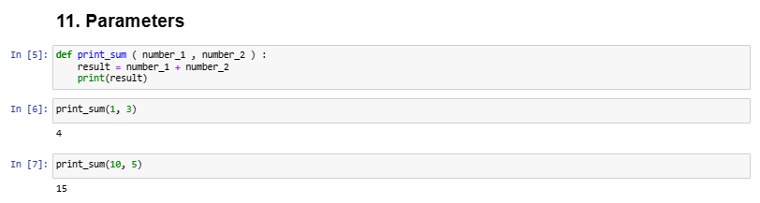
Parameters
Live coding
The values that we put inside a function are called “parameters”

Slide 75
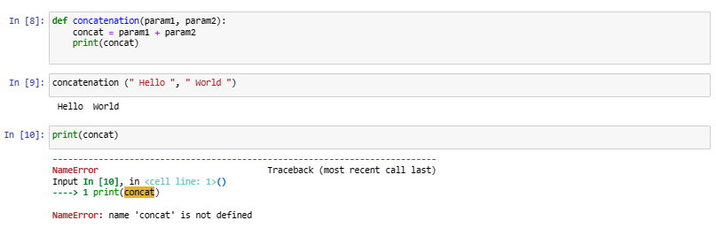
Variables that are inside a function can only be seen inside that function
Live coding

Slide 76
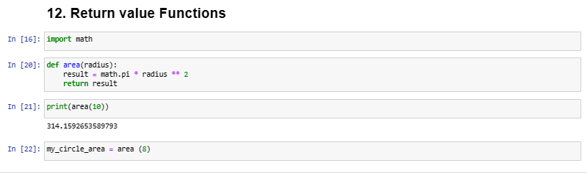
User Functions with Return Values: return
So far we have worked with functions that printed something, but that did not return a value.
Functions that return a value use the return keyword

Slide 77
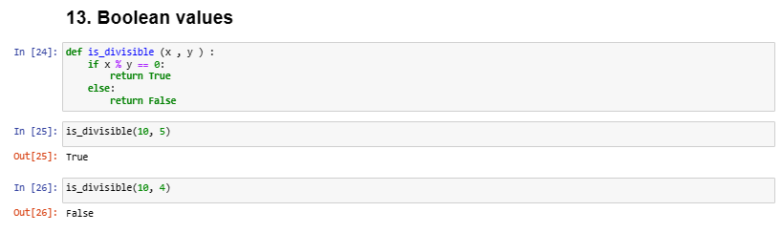
Boolean Return Values
Live coding
The functions can return a boolean value (True, False)
The function name should be formulated as a yes/no question

Slide 78
2. Control Flow
Conditionals (if/else/elif)
Iteration (for/while)

Slide 79
Conditionals: if/else/elif
if
The expression if defines a condition
If the condition is true, subsequent statements will be executed
If the condition is false, subsequent statements will not be executed
There has to be at least one statement after the condition

Slide 80
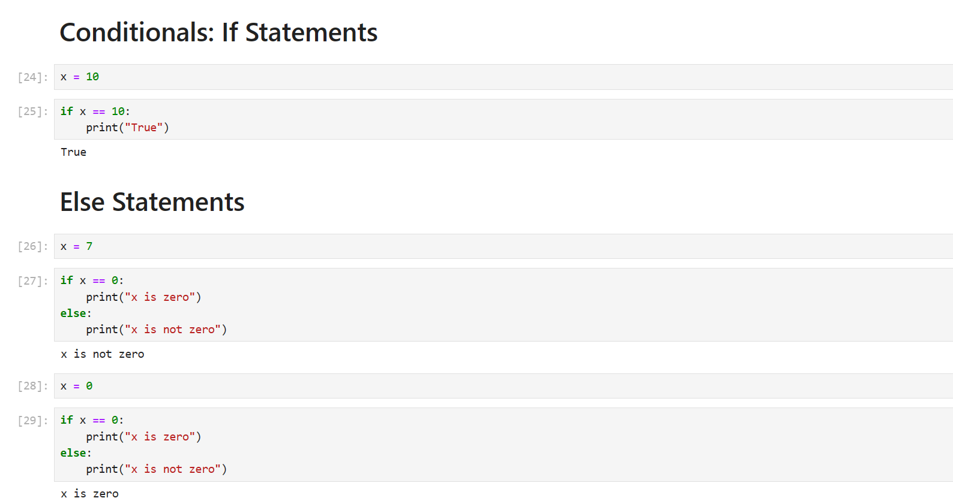
Live coding

Slide 81
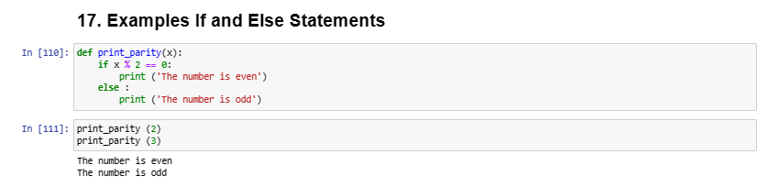
Let’s practice!
Live coding

Slide 82
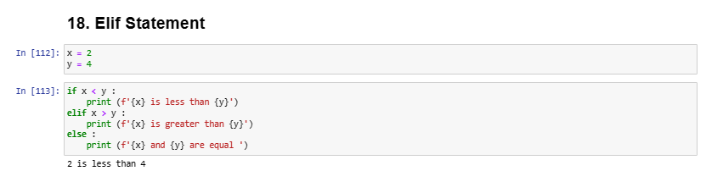
Chained Conditionals
Live Coding
elif is used to combine multiple conditions
The else expression is executed when neither if nor any of the elifs is true.
Any number of elif expressions can be used but only one if and one else.
Have a look at string formaters in here:
https://realpython.com/python-string-formatting/

Slide 83
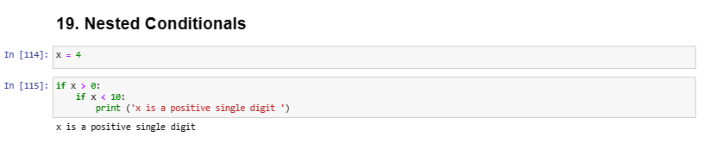
Nested Conditionals
Live coding
Conditionals can be nested

Slide 84
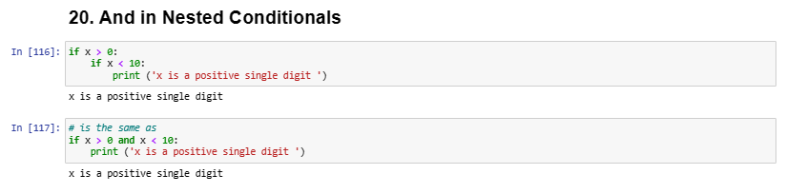
Nested Conditionals
Live Coding
Deep nesting can be difficult to read.
Use and to combine conditionals.

Slide 85
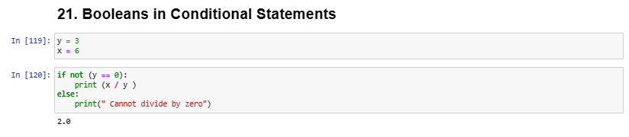
Booleans in Conditional Statements
not
Negation, inverts the boolean.
not True -> becomes False
not False -> becomes True
Live coding

Slide 86

Iteration: for/while
Iterations are used to repeat statements
There are two expressions for iterations
• while
• for
For: since it is often necessary to operate through lists and other data types, there is a special expression for this.
Until 2:12

Slide 87

For loops
Live coding

Slide 88

While loops
While loops are used to execute a set of statements as long as a condition is true.
Minute 4:00

Slide 89

While
While: as long as the condition of the while loop is True, the body of the loop gets executed.
If the condition is False at the beginning, the body of the loop is never executed.
If the variable that is used to check the condition of the while loop does not change, the loop will never terminate -> infinite loop.
Whether a while loop terminates can be hard to determine.
Live coding
Reference: https://www.w3schools.com/python/python_while_loops.asp

Slide 90

A clear example: PIN passwords
Live Coding
Reference: Learn C++ | Codecademy

Slide 91

While loops: list iteration
A while loop can be used to iterate through a list.
Live coding

Slide 92
2. Debbuging
Naming Conventions
Debugging

Slide 93
Naming Conventions
Naming convention is a set of rules for choosing names of functions and variables. It’s basically “programming language grammatical rules”.
Every programming language has different naming conventions. In Python:
• No spaces in variable and function names
• Variable and function names are in lowercase and _ is used to separate words
• It’s not possible to name a variable with a number

Slide 94

Naming Conventions
Live coding

Slide 95


Debugging
Programming is a complex activity
• Mistakes happen all the time
• A mistake made in programming is called a bug
• The process of finding and resolving bugs is called debugging
Debugging techniques
Reading code
Print variables with print() to examine values (a poor man’s debugger)
Go through the program step by step -> Debugger!

Slide 96

Exercises day 3

Slide 97
Day 4

Slide 98
Day 4
Basics of Reading and Writing Files
Pandas
Matplotlib

Slide 99
1. Reading and Writing Files

Slide 100

Reading and Writing Files
So far no data has been saved in any of our examples
All data was deleted from the memory as soon as our examples are removed
There are several ways to permanently store data:
• Database
• Simple text files
Live coding

Slide 101

Different reading modes
The mode defines how the content of the file should be treated
• ’r’: read only
• ’w’: write only
• ’r+’: read and write
• ’a’: append
Live coding

Slide 102

Pandas
Pandas is a software library written for the Python programming language for data manipulation and analysis. In particular, it offers data structures and operations for manipulating numerical tables and time series.
Pandas is particularly useful for creating, using, and exporting csv files (comma separated values).

Slide 103




Matplotlib
Matplotlib is a great library for visualization purposes that allows us to do different types of visualizations (line plots, scatter plots, bar plots, pie charts…)
Bar Plot
Line Plot
Pie Chart
Scatter Plot

Slide 104

Exercises Day 4 1. Reading and Writing Files 2. Learning how to do visualizations with Matplotlib

Slide 105


Thank you for your attention!
References:
Philipp Gloor (2022): Python Basic Introduction, https://gitlab.uzh.ch/zi-it-training/appb/APPB2_HS22.
David Pinezich (2021): Python Basic Introduction, https://gitlab.uzh.ch/zi-it-training/appb/appb_dp_hs21/-/tree/master/
https://wesmckinney.com/book/data-cleaning.html#text_string_methods
You can also find extra Python resources in here:
Stack Overflow: https://stackoverflow.com/
Excellent Textbook 1: Composing Programs (http://composingprograms.com/)
Excellent Textbook 2: Computational and Inferential Thinking (https://inferentialthinking.com/chapters/intro.html)

